Slide 1
Raft Introduction
Dang Zhonghua
2019-05-31

Slide 2
Raft is one kind of consensus algorithm which means in 2f+1 server cluster, it can allow at most f server failure concurrently. This algorithm is used to reliable system/high availability.
Raft is easy-understandable version of (Multi-) Paxos
Paxos series algorithm use the mode of “Replicated State Machine”: One set of servers, if all of these servers’ state is the identical initially, then apply identical operation in the same order, all servers will be reach the same state.
Replicate State Machine is used to solve various fault tolerance in distribute system.
Replicate State Machines are always implemented by Replicated log this is Raft and Paxos Usage: to ensure that every log eventually contains the same requests in the same order,

Slide 3
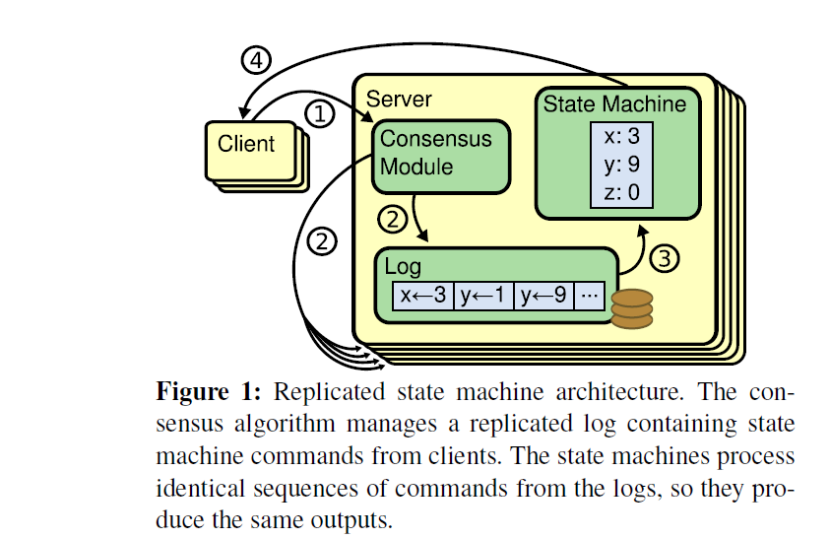

Slide 4
Consensus Algorithm Properties
Ensure Safety
Availability (liveness)
At extreme case, failure can ONLY effect liveness, NOT the consistency.

Slide 5
The essential of Paxos
Paxos first defines a protocol capable of reaching agreement on a single decision, such as a single replicated log entry
Paxos ensure safety and liveness.

Slide 6
The subproblems that raft solved
Leader election: a new leader MUST be chosen when an existing leader fail
Raft use leader to simply consensus algorithm understandability and simply data flow
Raft use leader to accept client request and decide the log entries and command other servers to handle log entries.
Log Replication: The leader MUST accept log entries from client and REPLICATE them across the cluster, forcing the log to agree with its own.
Safety: ensure the safety across servers: if one server apply log entries into state machine in particular log, then other servers must the log entries in the same order. This need help of leader election.

Slide 7
State of server of Raft Cluster
At any time each server is in one of three states: leader: Only leader state can handle client request. At most one leader in Raft cluster at any time follower: they issue no requests on their own but simply respond to requests from leaders and candidates candidate: the state is ONLY used to elect new leader

Slide 8
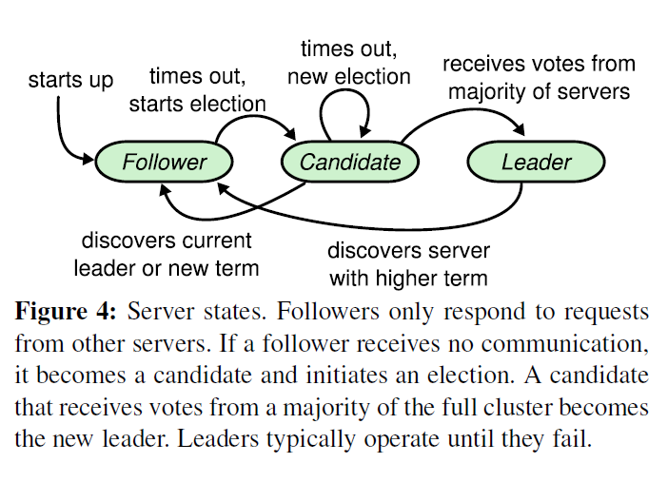

Slide 9
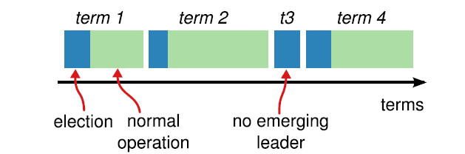
Raft Server State
These States transition between terms ( time window)
Time is divided into terms, and each term begins with an election. After a successful election, a single leader manages the cluster until the end of the term. Some elections fail, in which case the term ends without choosing a leader. The transitions between terms may be observed at different times on different servers( this is nature in distribution system since individual server may incur different events).
But Raft ensure at most ONLY one leader in given term.

Slide 10
Term acts as logical clock, and they allow servers to detect obsolete information such as stale leaders. Each server stores a current term number, which increases monotonically over time.
Current terms are exchanged whenever servers communicate; if one server’s current term is smaller than the other’s, then it updates its current term to the larger value. If a candidate or leader discovers that its term is out of date, it immediately reverts to follower state. If a server receives a request with a stale term number, it rejects the request.
This means these states are ONLY with in one term.
Message Types: Vote message and append log message which also used to heartbeat

Slide 11
Raft Leader Election

Slide 12
Log Replication
Leader append client command into local log files.
Send the new log entries t other servers within the cluster.
A log entry is committed once the leader that created the entry has replicated it on a majority of the servers. This also commits all preceding entries in the leader’s log, including entries created by previous leaders. There are subtleties when apply rule after leader change

